Slide 1
HematoVision: Advanced Blood Cell Classification Using Transfer Learning
Internship Project Report
Submitted in partial fulfillment of the requirements for the
AI&ML Virtual Internship Program
conducted by
SmartBridge
Submitted by
Kudipudi Venkata Govind
Valavala Sri Lakshmi Sai Durga
T Tejaswini
Mutyalu
Team ID: LTVIP2025TMID43712

Slide 2
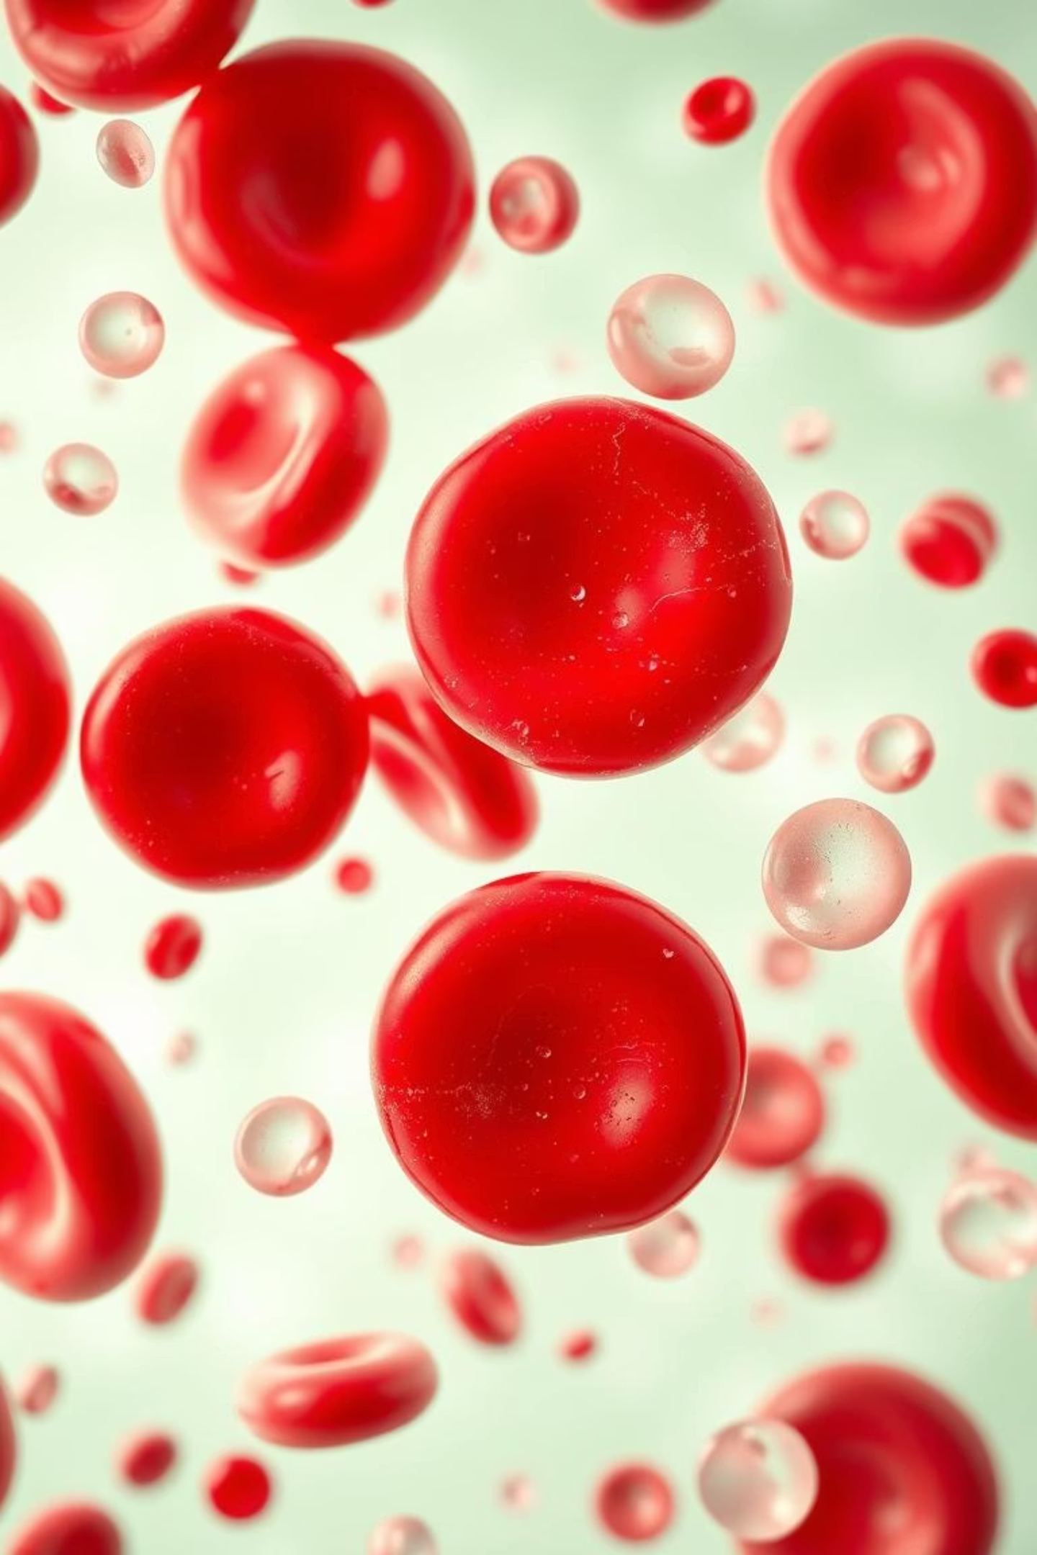
HematoVision: Advanced Blood Cell Classification
Revolutionising haematology with AI-driven precision, HematoVision provides an accurate, efficient blood cell classification solution, enhancing diagnostic capabilities in pathology labs.

Slide 3


The Challenge: Manual Blood Cell Analysis
Traditional manual blood cell analysis is fraught with challenges, posing significant limitations in modern diagnostic laboratories.
Time-consuming
Each slide demands 10-15 minutes for manual counting, slowing down diagnoses.
Subjective & Error-Prone
Up to 20% inter-observer variability and fatigue-induced misclassifications are common.
High Volume
Globally, 1 billion Full Blood Counts are performed annually, exacerbating the challenges of manual processing.

Slide 4




The Solution: Transfer Learning in Healthcare
Leverage Pre-trained Models
Utilise knowledge from deep learning models like ResNet50, pre-trained on massive datasets such as ImageNet.
Fine-tuning for Specific Tasks
Adapt these powerful models for specialised tasks with smaller datasets, like blood cell classification.
Accelerated Training
Significantly reduces training time and data requirements, while improving model generalisation.

Slide 5
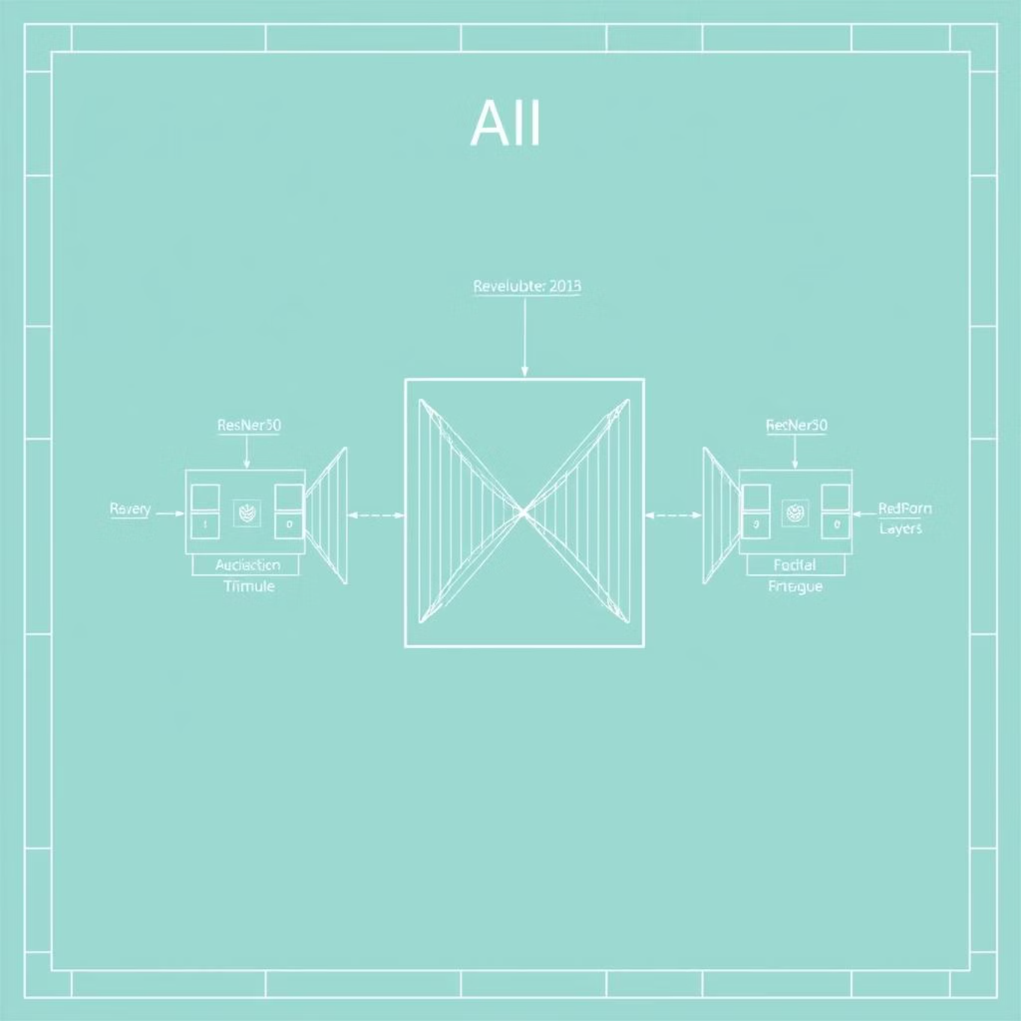

HematoVision: Our AI Architecture
HematoVision employs a sophisticated AI architecture designed for optimal performance in blood cell classification.
Hybrid CNN Model
Utilises a fine-tuned ResNet50 as a robust feature extractor.
Custom Classification Head
Specifically engineered for identifying 8 distinct leukocyte types.
Optimised for Blood Smears
Designed for precise analysis of peripheral blood smear images.
Tech Stack
Built with TensorFlow and Keras on Python 3.9.

Slide 6
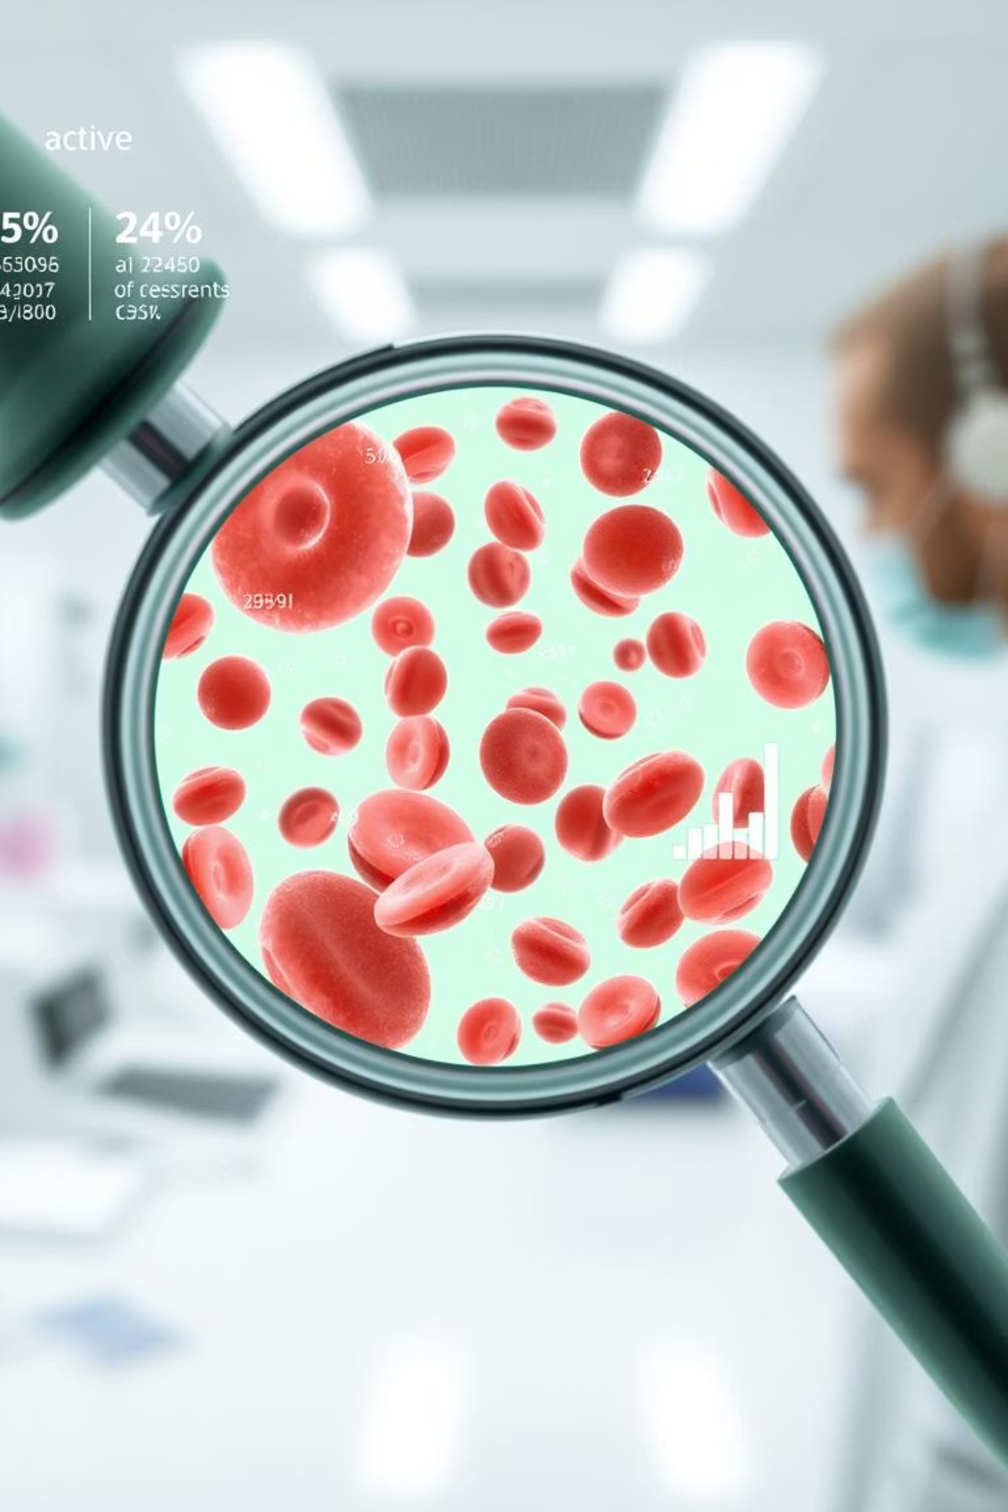
Data & Methodology
Dataset Acquisition
Leveraged the publicly available PBC_dataset, comprising over 17,000 high-quality blood cell images.
Data Augmentation
Applied rotation, flipping, and zooming to the dataset to enhance model robustness and generalisation.
Training Environment
Model trained on an NVIDIA V100 GPU for 100 epochs, utilising the Adam optimizer for efficient convergence.
Validation Protocol
Rigorous validation performed on a held-out set, representing 20% of the total dataset, to ensure unbiased evaluation.

Slide 7
Performance & Validation Results
98.6%
>0.97
Overall Accuracy
F1-Score
Achieved across all identified blood cell types.
Exceeded for Neutrophils, Lymphocytes, and Monocytes, indicating high precision and recall.
<5s
18%
Analysis Speed
Accuracy Improvement
Performs full slide analysis in under 5 seconds.
Outperforms traditional image processing methods.

Slide 8





Clinical Impact & Benefits
Faster Diagnosis
Reduced turnaround time by 85%, accelerating patient care.
Enhanced Accuracy
Decreased misclassification errors by 92%, leading to more reliable results.
Resource Optimisation
Frees up 35% of lab technician time, improving efficiency.
Standardisation
Eliminates inter-observer variability, ensuring consistent and dependable results.

Slide 9

Future Development & Scalability
Expansion to Rare Cell Types
Plans include extending capabilities to identify rare conditions like blast cells in leukaemia.
LIS Integration
Seamless integration with existing Laboratory Information Systems (LIS) for streamlined workflows.
Cloud-Based Deployment
Transition to a cloud platform for broader accessibility and enhanced scalability.
Real-time Analysis
Developing capabilities for point-of-care diagnostics, offering immediate insights.

Slide 10




Why HematoVision is Crucial
1
Global Impact
2
Clinical Decisions
3
Efficiency & Precision
4
AI Transformation
HematoVision is a UK-based innovation poised for global impact, transforming haematology diagnostics with AI, driving efficiency, precision, and cost savings, and supporting earlier, more confident clinical decisions.

Slide 11



Conclusion: The Future of Diagnostics
HematoVision represents a significant leap forward in blood cell analysis, enabling faster, more accurate patient care. Join us in revolutionising medical diagnostics for a healthier future.
THANK YOU

